Slide 1
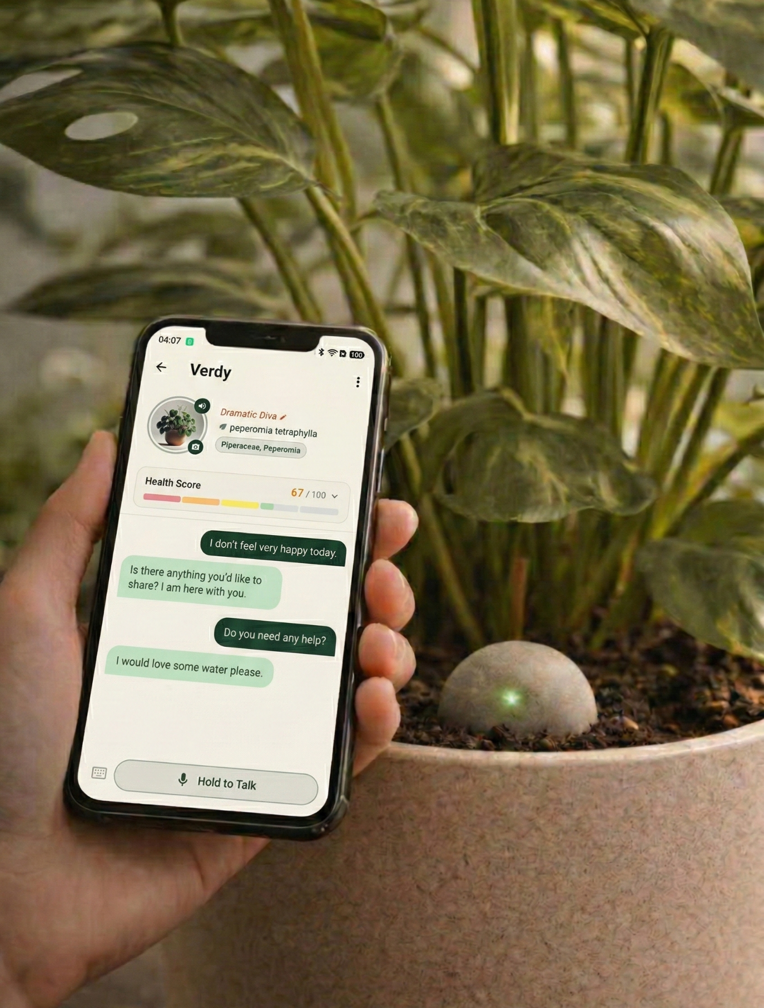
LeafAlive
Turning plant care into companionship
03/01/2026
Notes:
We’re building LeafAlive, an AI-powered plant companion that transforms real biological signals into emotionally grounded conversations.
Instead of alerts and dashboards, your plant develops a voice, a personality, and a relationship with you.

Slide 2
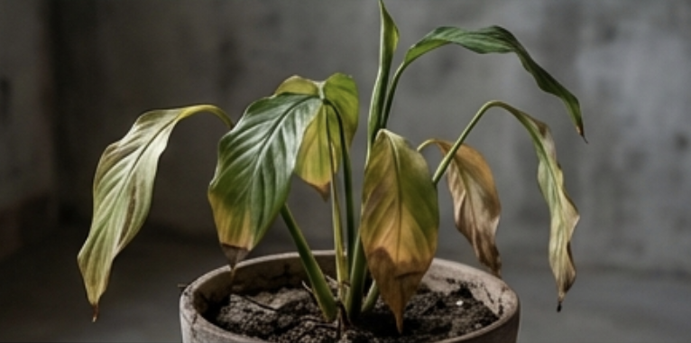

The Problem
70% of house plants die in Year 1.
Plant care is easily overlooked.
Current IoT devices are reactive, not preventive.
No emotional connection, no lasting care.
Notes:
Most houseplants don’t survive their first year.
Not because people don’t care, but because care is inconsistent.
Life gets busy.
And current technology only reacts after something goes wrong.
Without emotional connection, there’s no lasting commitment.

Slide 3
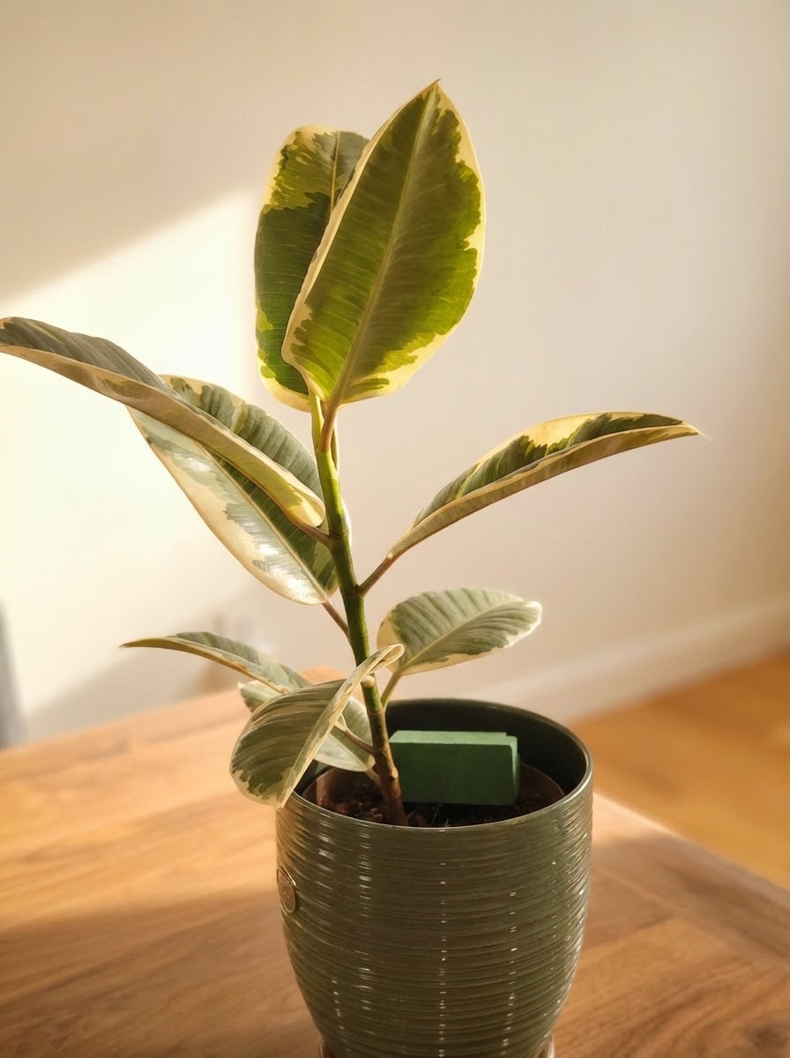
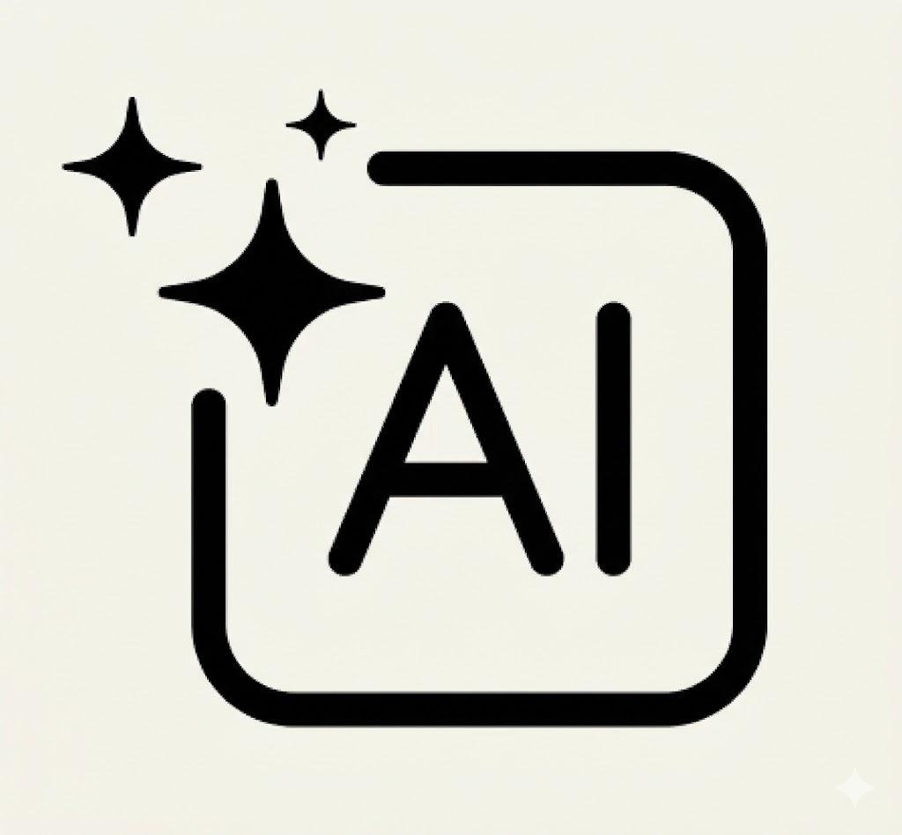
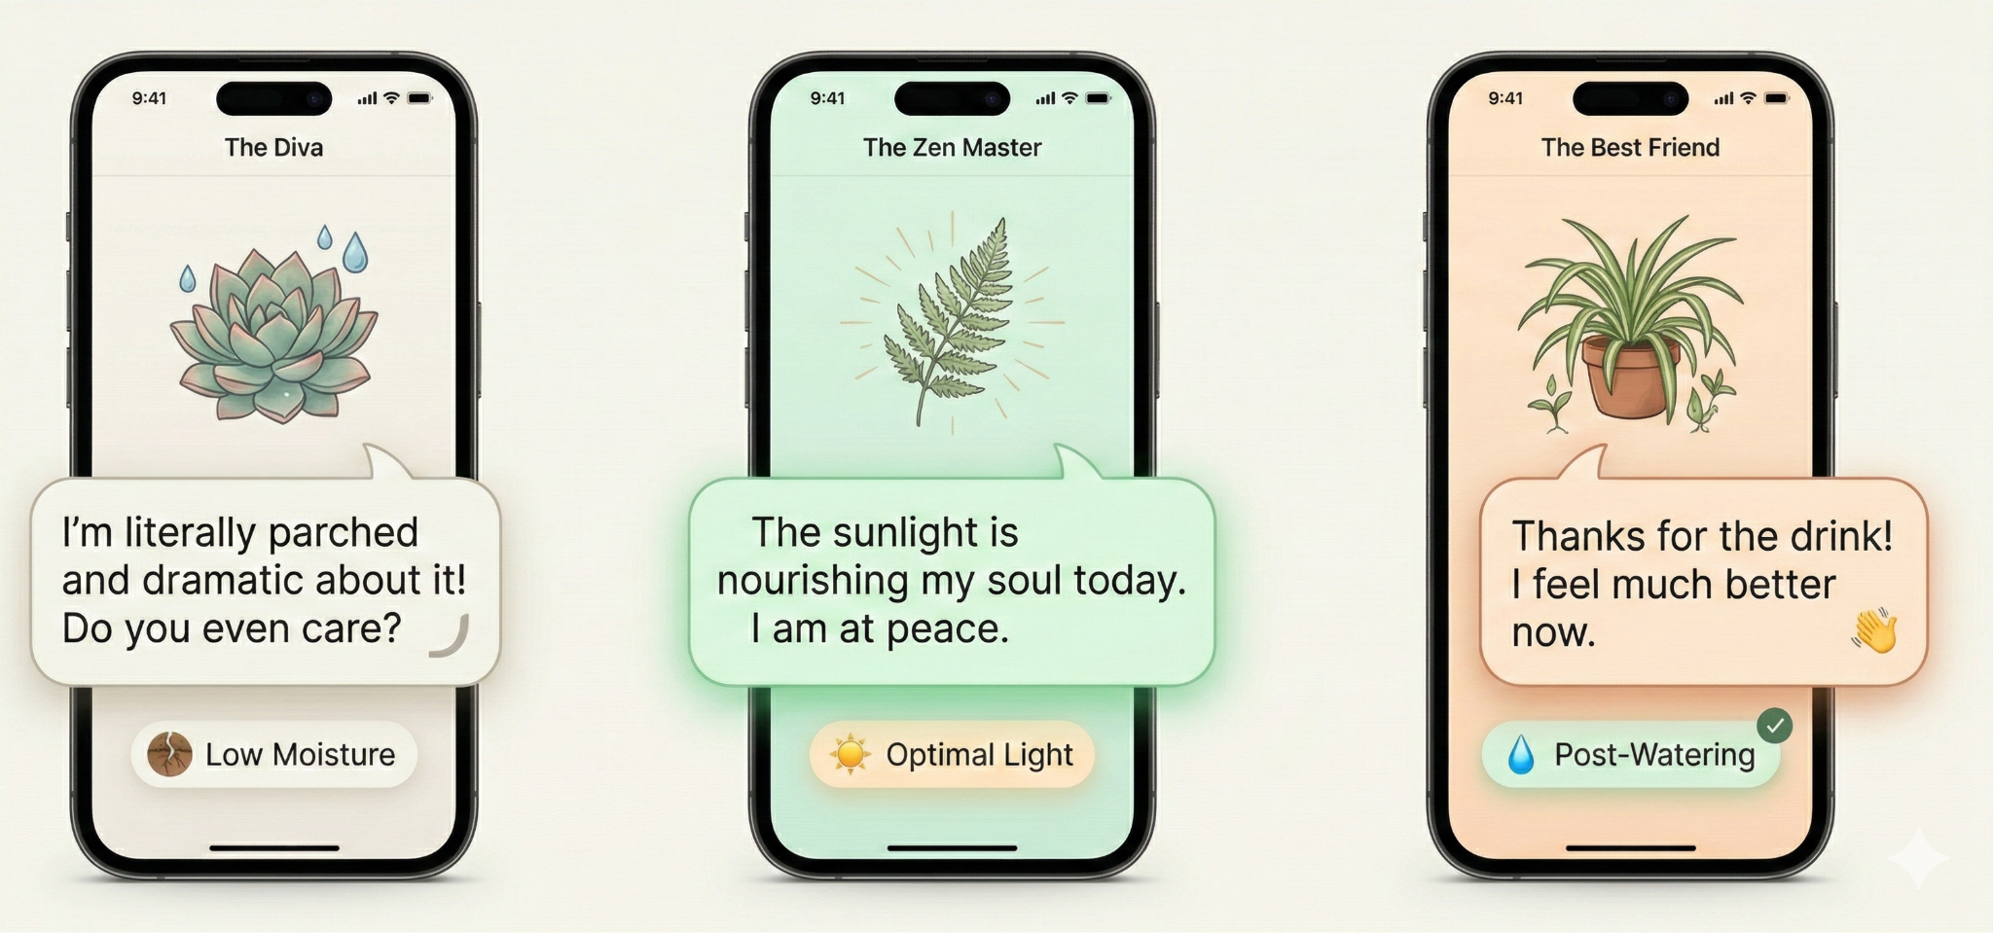
Our Solution
🌿 Real-time environmental sensing
🤖 AI-powered plant persona
💬 Proactive human-plant interaction
Notes:
LeafAlive combines real-time biological sensing with a persistent AI persona.
The plant’s tone and personality are grounded in its actual environmental state.
But what makes it different is proactive design.
Instead of reacting to emergencies, the plant gently initiates conversations and builds small care rituals over time.
This shifts the experience from alerts to relationship.

Slide 4
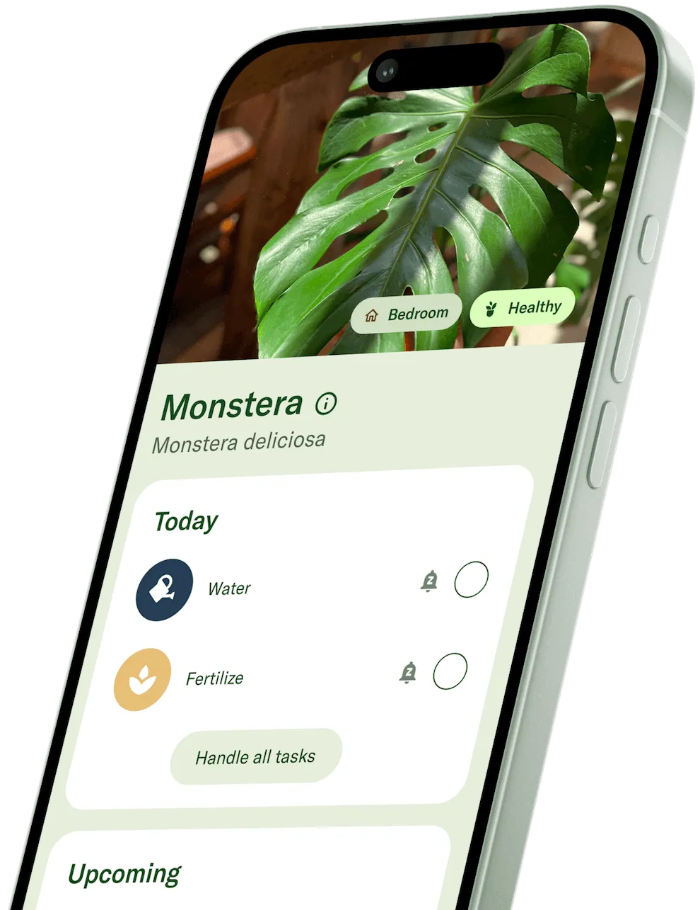
Shifting from Chore to Relationship
Existing technology reduces plants to notifications and dashboards.
LeafAlive uses human–AI interaction to cultivate human–plant companionship. We do more than keep plants alive; we support user well-being through the act of nurturing.
Source: Planta
Notes:
Today’s plant technology is one-directional. You care for the plant. It sends you alerts. That turns care into a chore.
LeafAlive creates a bidirectional relationship. You care for the plant’s biological needs. And the plant responds emotionally, checks in, and becomes a gentle presence in your life.
Care becomes connection.

Slide 5
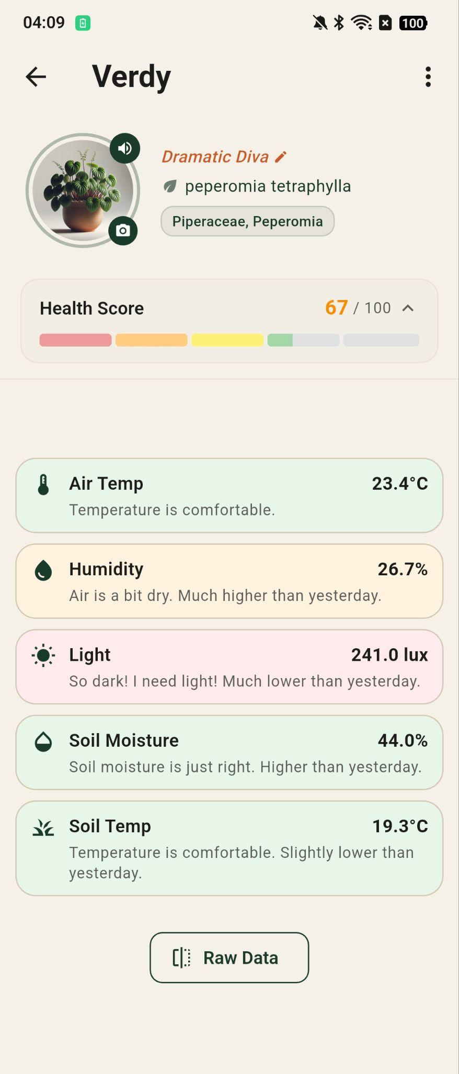
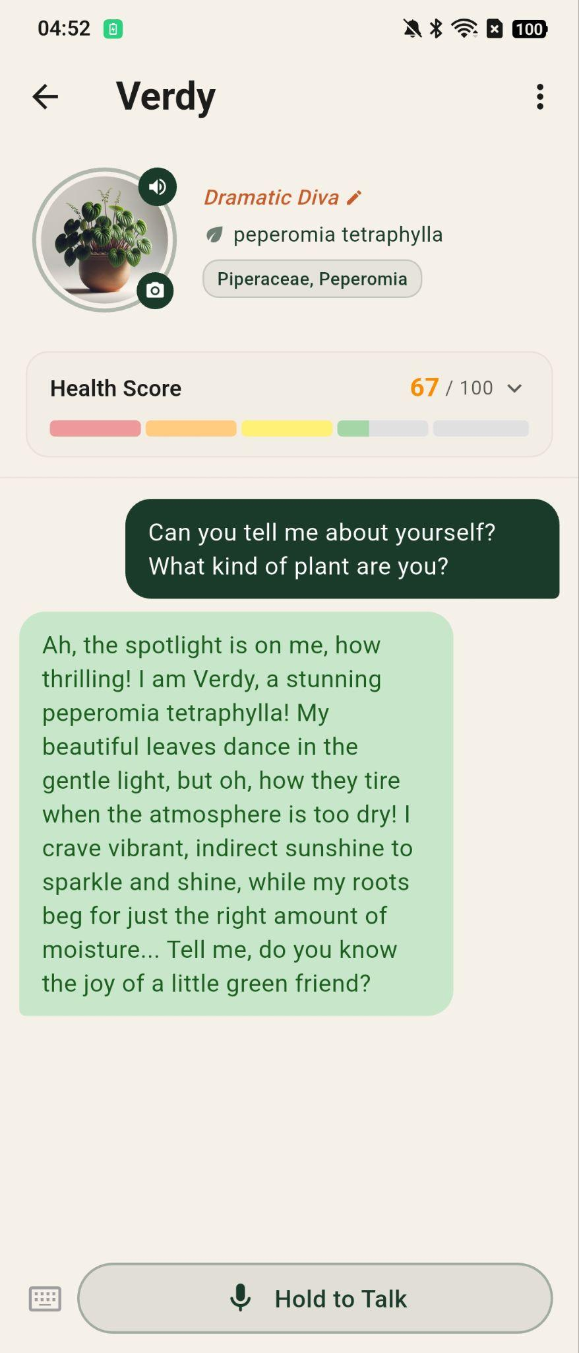
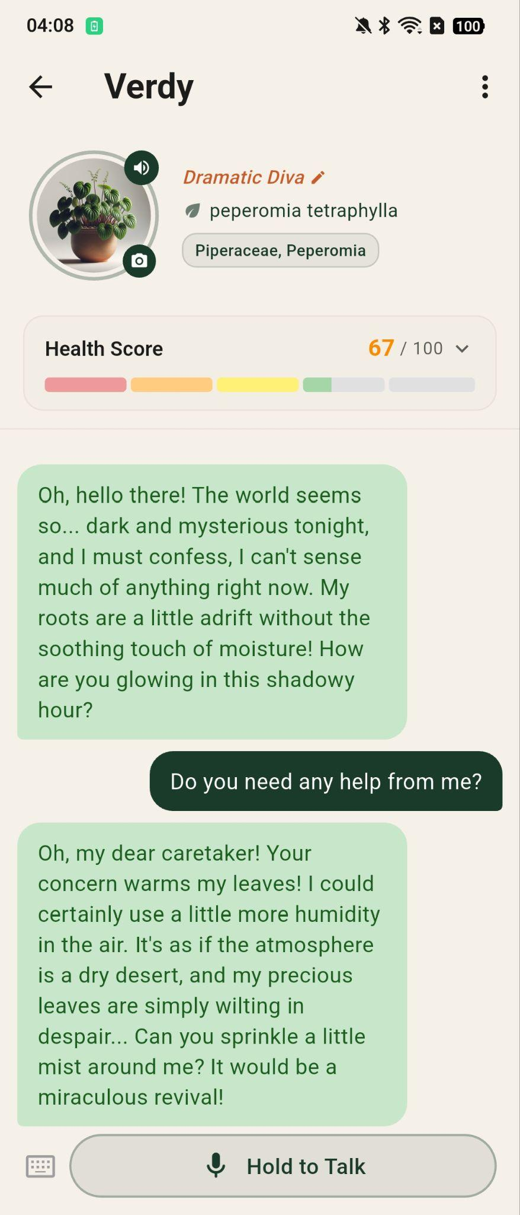
How it works
A living interface powered by real data
Health Score Real-time moisture, light, temperature
AI Persona Persona grounded in sensor data
Proactive Chat Bidirectional human-plant care
Health Score
AI Persona
Proactive Chat
Notes:
LeafAlive begins with live biological sensing.
We translate those signals into a dynamic health score and persona model.
That mood shapes a persistent AI persona with memory and voice.
And instead of waiting for problems, the plant proactively initiates care to humans and conversations.
This creates a bidirectional loop.
You care for the plant’s biological needs.
The plant responds emotionally and becomes a gentle presence in your life.

Slide 6
Market: Rise of Plant Parents
66% of U.S. households own houseplants (2021)
U.S. gardening market: $50B+ annually (2025)
Plant care & AI companions growing rapidly
Current Plant Care Apps
Planta • PictureThis • Blossom
→ Dashboards & reminders
Current Smart Sensors
Xiaomi • MiFlora • Netro
→ Data without personality
No solution combines real sensing + AI.
Notes:
The opportunity is large and growing. Sixty-six percent of U.S. households own houseplants, and the gardening industry exceeds fifty billion dollars annually. At the same time, smart home devices and AI companions are rapidly normalizing emotionally expressive interfaces.
Existing solutions either provide dashboards and reminders, or raw sensor data. None combine real biological sensing with emotionally grounded AI. That’s the gap LeafAlive fills.

Slide 7
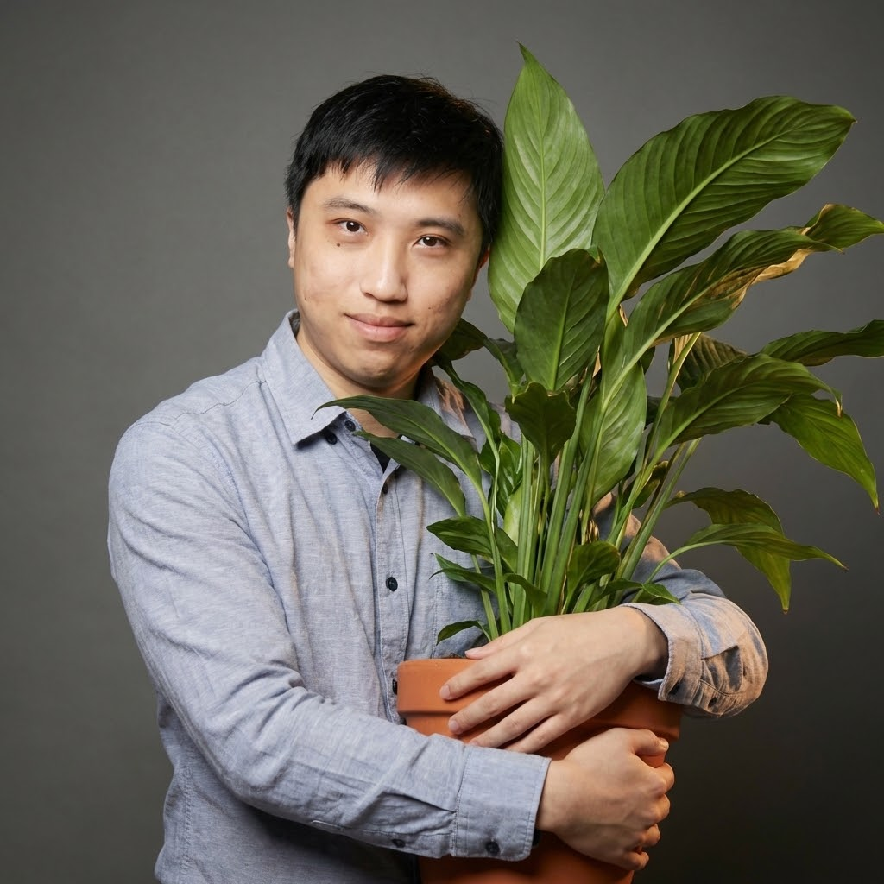

Meet the Team
Zhijian Ren, PhD
Hang Jiang, PhD
Co-Founder, LeafAlive
PhD, MIT EECS
Robotics & Embedded Systems
Co-Founder, LeafAlive
PhD, MIT Media Lab
AI & Human-Computer Interaction
Notes:
We combine deep hardware expertise with AI and human-AI interaction design.
Together, we’re building the first emotionally grounded plant companion.
We’re looking for partners and early supporters to help us scale hardware production and pilot deployments.
We believe the next generation of interfaces will feel alive.
And we’re building that future.

